Slide 1
2015 Annual General Meeting
Report from Meeting April 14, 2015

Slide 2
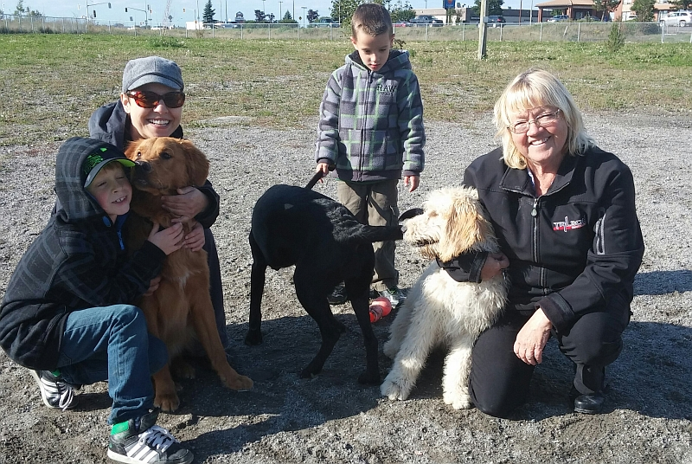
Happy Dogs - People

Slide 3
Volunteer Association
Subcommittee of the Minnow Lake CAN
Volunteer Association (not incorporated not for profit)
Helps educate new users, runs events at the park, runs projects to make the park better, does fundraising
Liaises with the City of Greater Sudbury’s Recreation department.

Slide 4
Volunteer Association
Assets: $2,712.45 in City and CAN bank accounts
Accomplishments:
  Additional parking (2013)
  Lighting (2013)
  Accessibility- bridge + reserved parking (2013)
  Surface enhancements – grass and crusher dust (2013)
  Picnic tables – Home Depot donation (2013)
  Maintenance equipment – Home Depot donation (2013)
  Washroom facilities (2014)
  Recycling facilities (2014)
  Tree planting (2013 and 2014)
  Signage (2013 and 2014)
  Flyers (2013)
  Social media - website, facebook (2013)

Slide 5
Volunteer Association
Future enhancements to park
  Accessibility to large dog park + other accessibility issues
  Additional surface enhancements
  Shelters (partnership with Home Depot)
  Water/cleaning stations
  Dog agility/exercise equipment
  Storage shed
  Signage at entrance
  Additional park beautification
Annual reports available on website: dogsoffleash.ca

Slide 6
Current Executive Committee
President: Dean Eyre
Vice-President/Treasurer: Vacant
Recorder: Vacant
Communications/Projects: Rachelle Niemela
Activities Coordinator: Vacant
Certified Trainer Educator: Karen Ann
Fundraising Coordinator: Linda Moro
Small Dog Representative: Suzanne Harrison
Large Dog Representative: Linda Hachez
Members at large: Dan McDougall

Slide 7
2015 Projects
Shelters
Additional tree planting and grounds beautification – applied for TD Friends of the Environment grant
Water to park
Additional ground work (grass, crusher dust, etc.)
Dog exercise equipment
Storage shed: partnership with Community Gardens
Signage at entrance

Slide 8
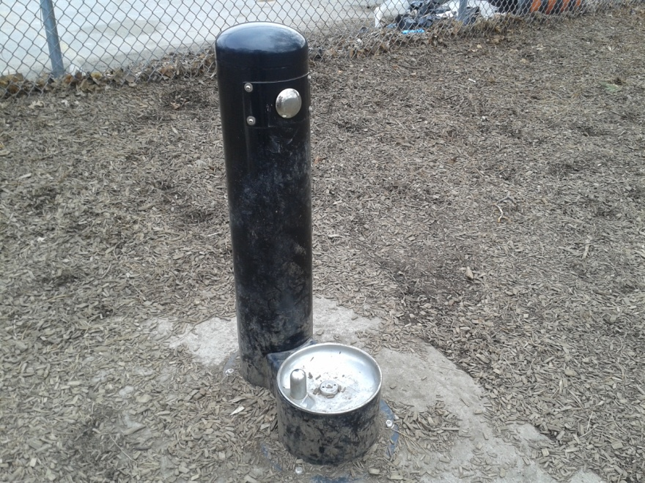
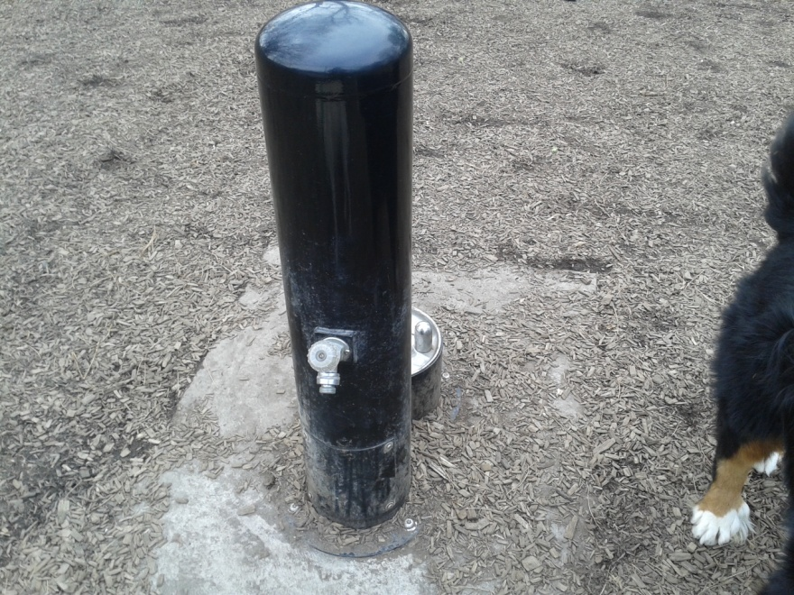
Water

Slide 9
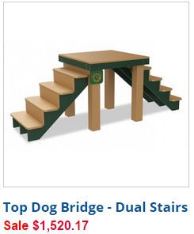
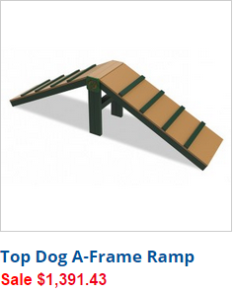
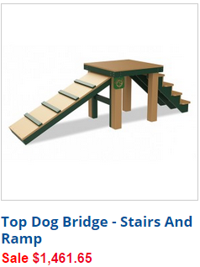
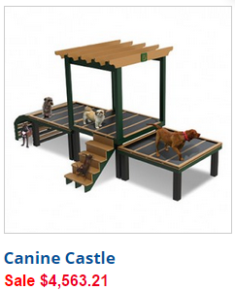

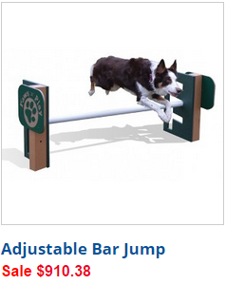
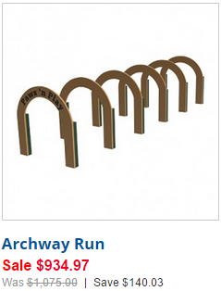
Exercise Equipment

Slide 10
2015 Events
Spring cleanup – May 24th
Open house
Woof Fest
Dog Training workshops
Major fundraising event?

Slide 11
You are invited:
MINNOW LAKE DOG PARK
ANNUAL SPRING CLEANUP
SUNDAY, MAY 24, 2015
10 AM – 1 AM
MINNOW LAKE DOG PARK
SECOND AVENUE

Slide 12
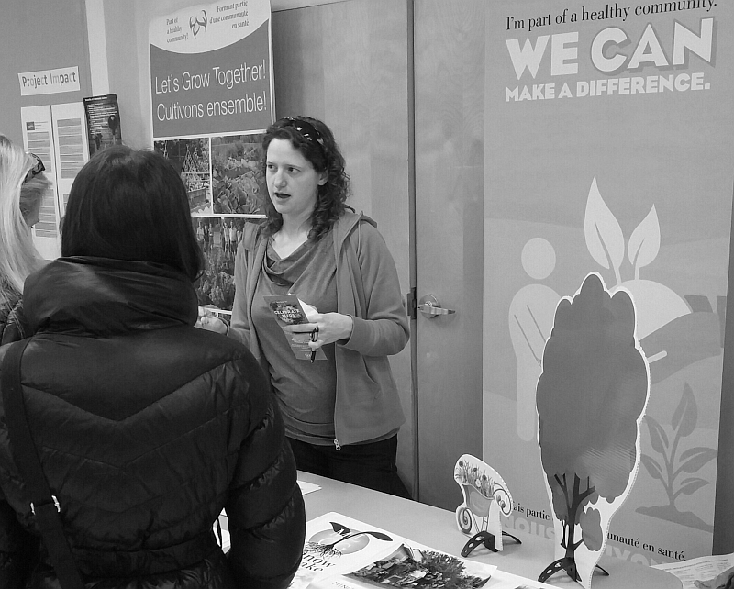
Community Gardens in Minnow Lake – Different Locations – New?

Slide 13
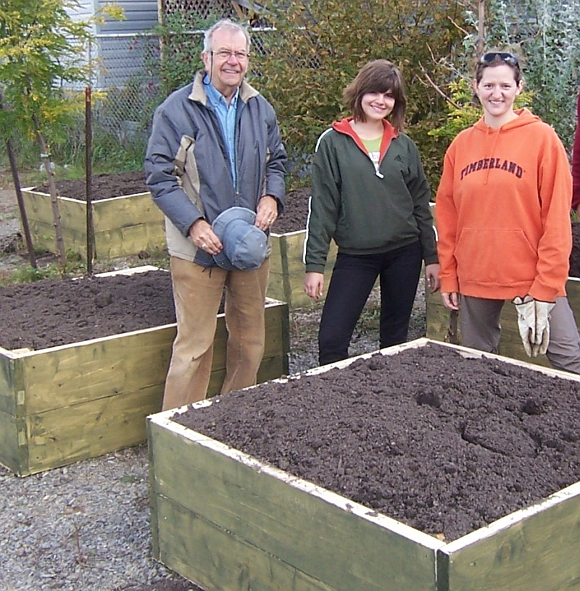
Community Gardens - Beginning

Slide 14
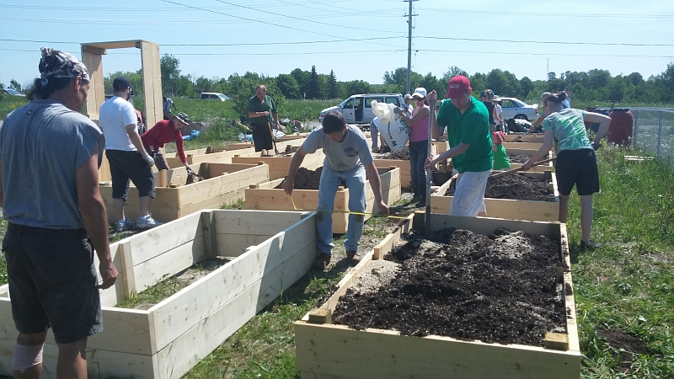
Community Gardens - Expansion

Slide 15
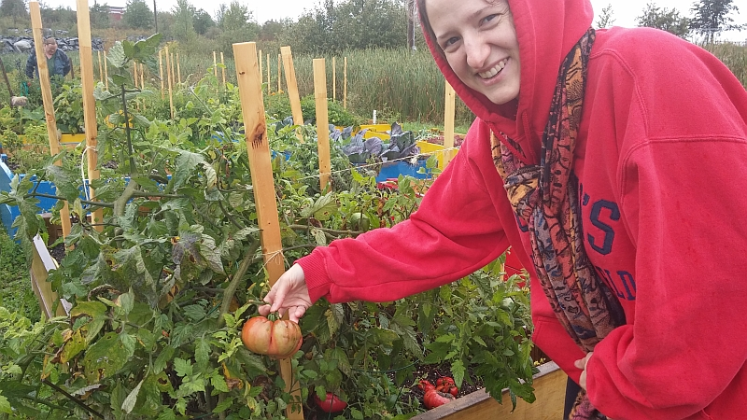
Garden Harvest

Slide 16
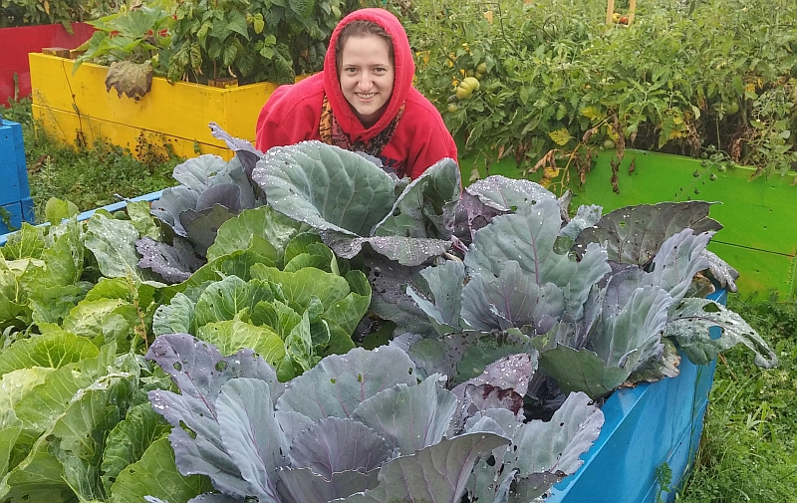
More Good Harvest of 2014

Slide 17
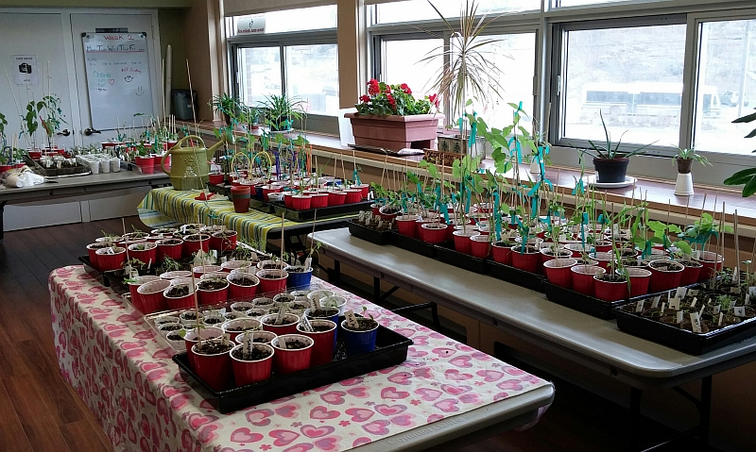
Getting Ready for 2015 Planting

Slide 18
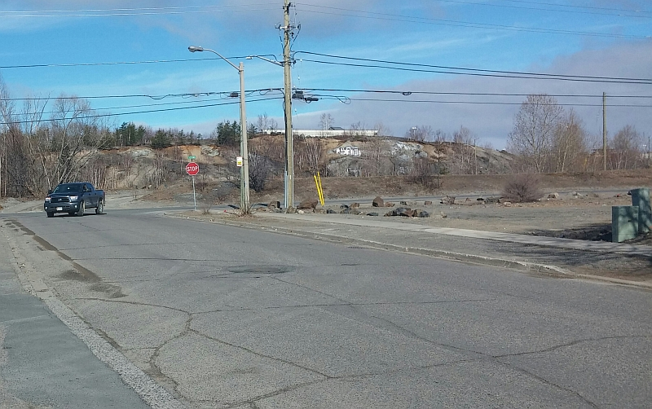
How about more gardens – where?

Slide 19
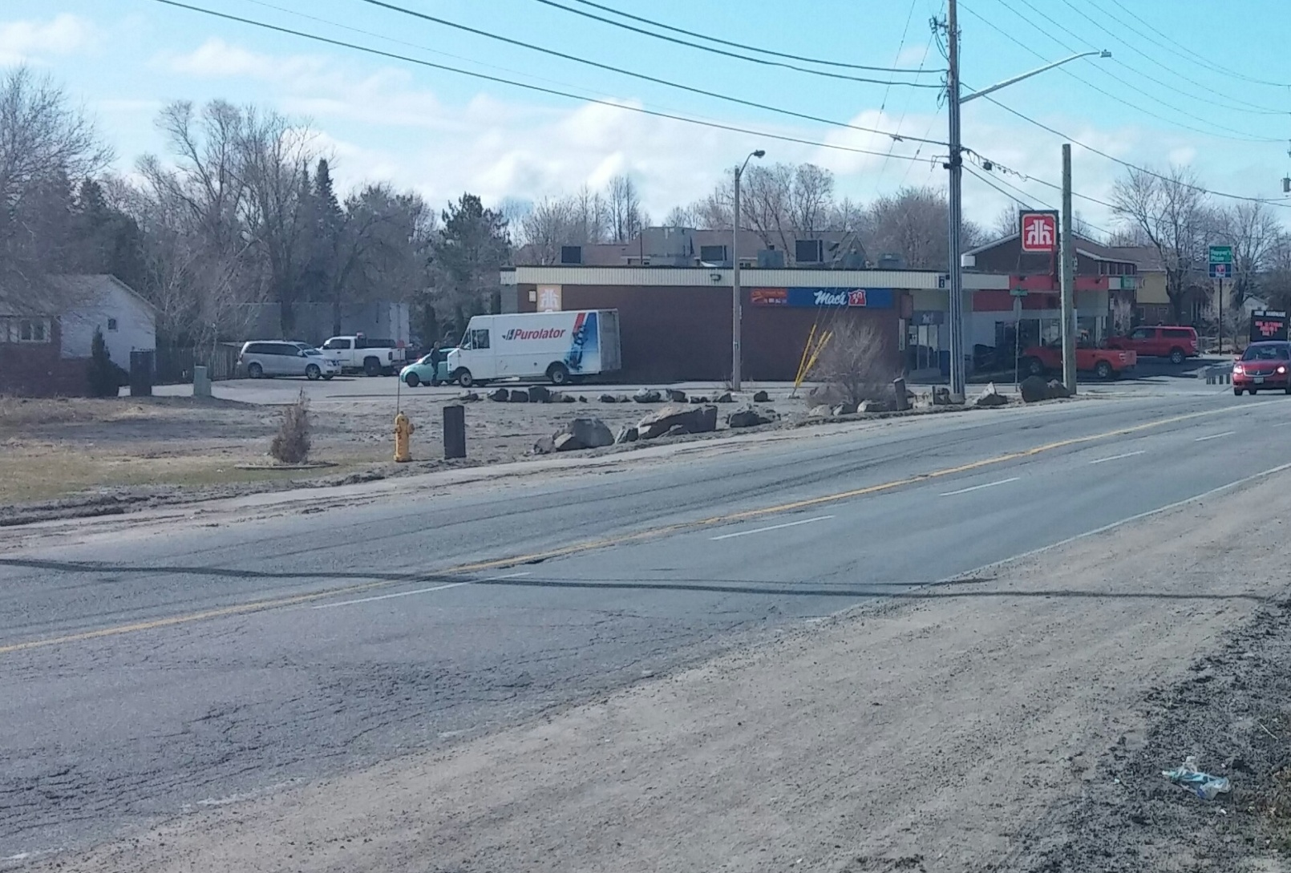
Corner of Second and Scarlet?

Slide 20
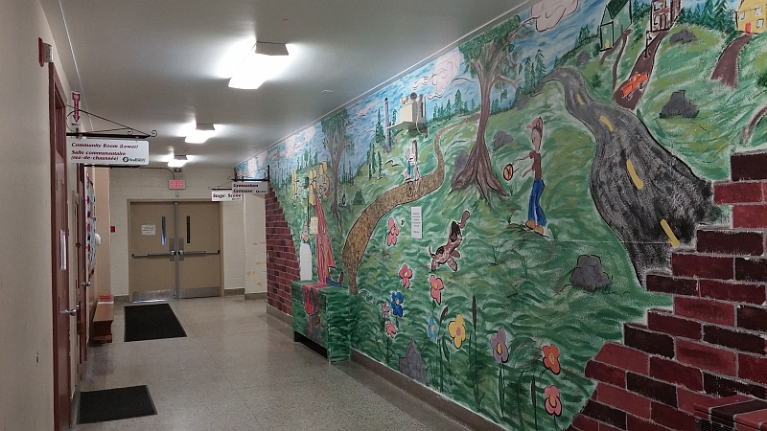
Minnow Lake Place Plans – First Floor Mural brightens hallway

Slide 21
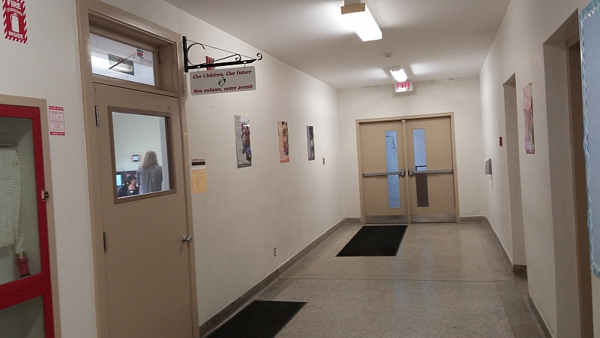
How about mural on these walls?

Slide 22
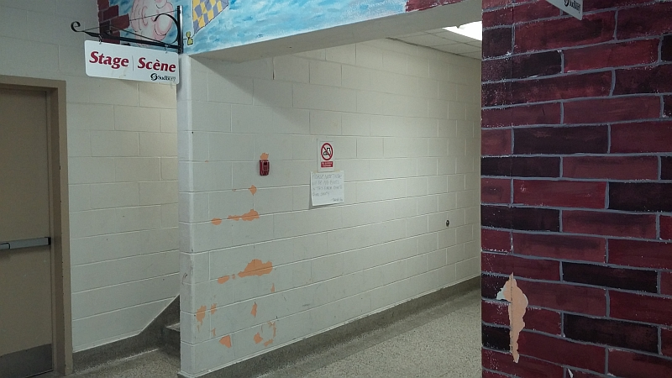
And on Entrance to Gym -Stage

Slide 23
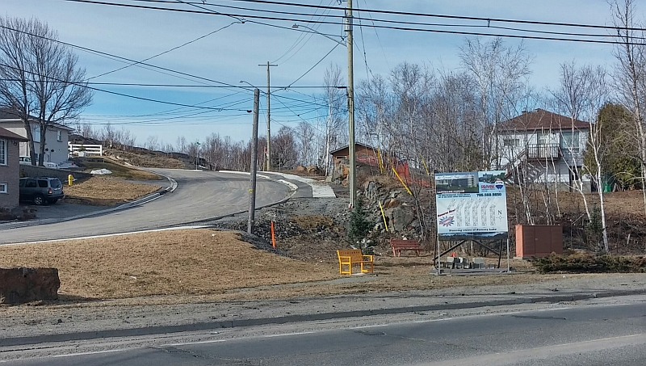
Bellevue Park Restoration

Slide 24
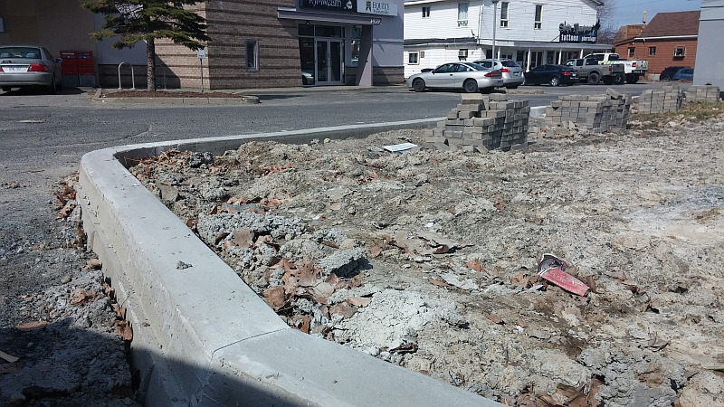
Other Site Plan Improvements

Slide 25
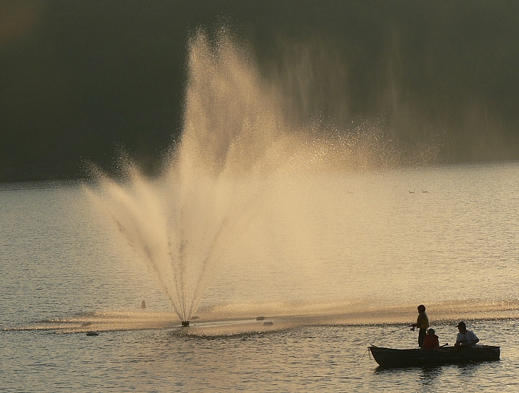
Looking forward to Summer and yes there are fish in Minnow Lake

Slide 26
Prepare for the Future

Slide 27
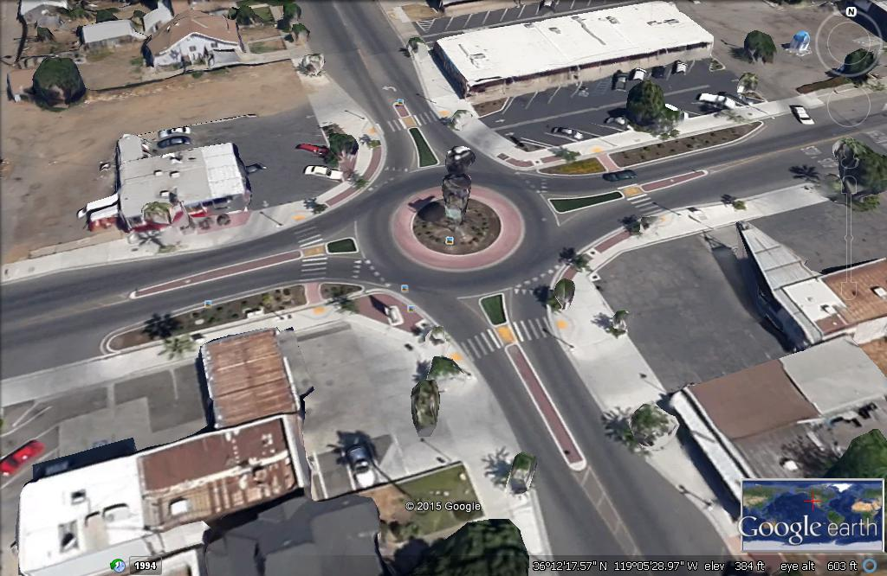
On Lane Roundabout in Urban Setting with retail on corners

Slide 28
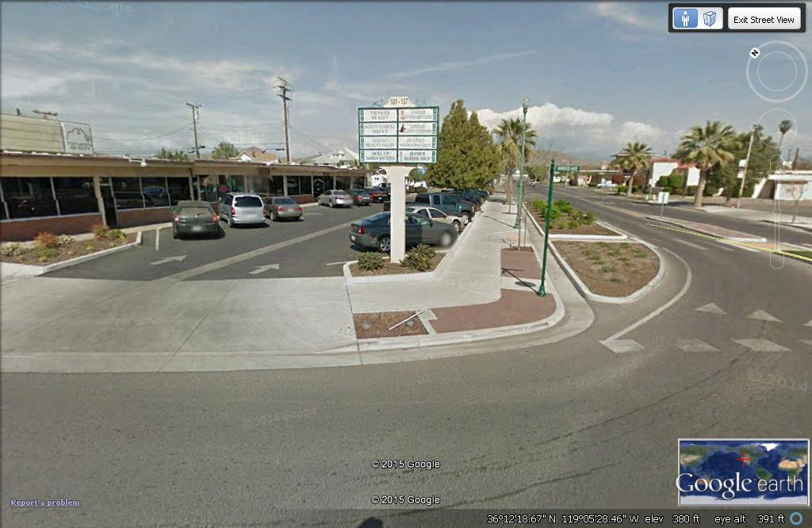
Showing Mall on Roundabout corner – one way in and out

