Slide 1
Ramsey Lake Subwatershed: How well are our environmental protection efforts really working?
Brad Bowman
Senior Environmental Scientist
N.A.R. Environmental Consultants Inc.

Slide 2
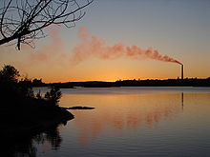
Risks to Ramsey Lake
Ramsey Lake provides approximately 30% of the drinking water to the City of Greater Sudbury.
However, the lake is susceptible
to non-point source
contamination.

Slide 3
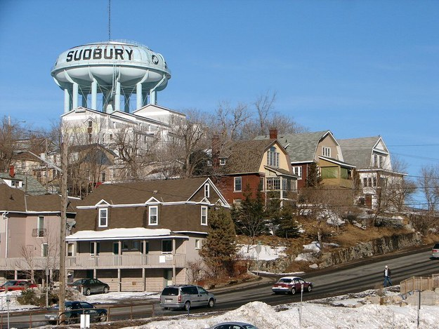
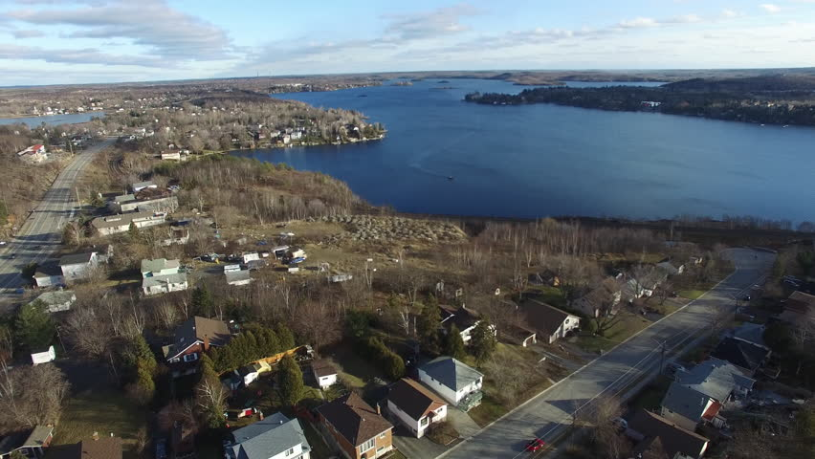
It is located in an urbanized area; close to major routes, storm sewer system, fuel spills; and is used for multiple recreational uses).

Slide 4
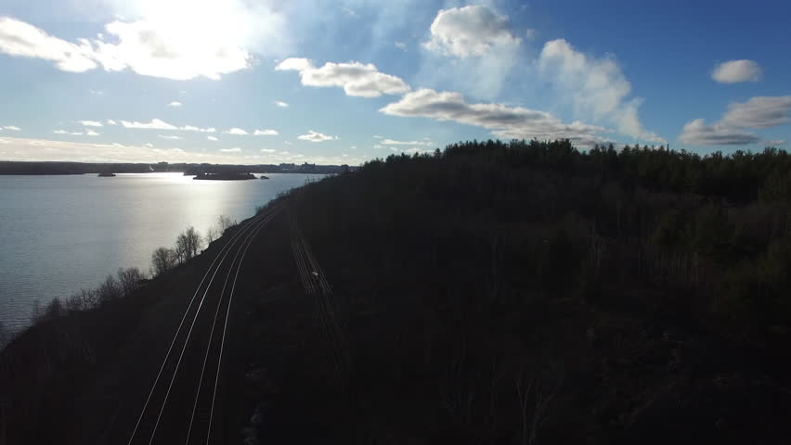
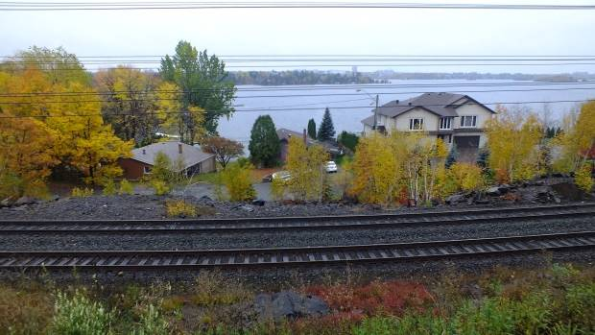
CP rail line is located within the sub-watershed

Slide 5
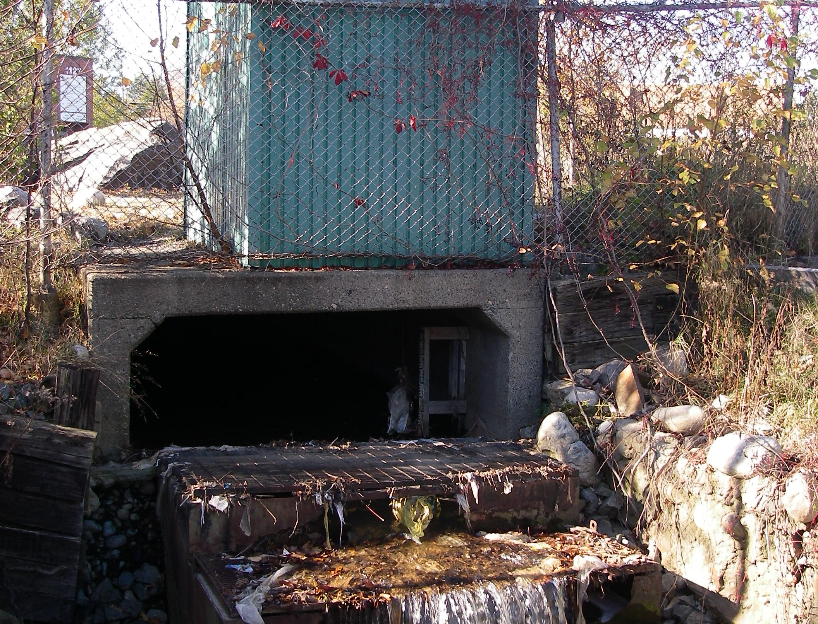
Multiple storm sewers directly discharging to the lake, plus several sub-sub-catchments (Minnow Lake, Frobisher Creek and Lake Laurentian)
Two of these are highly urbanized (Minnow Lake and Frobisher Creek) and the third a protected wetland habitat (Lake Laurentian).

Slide 6
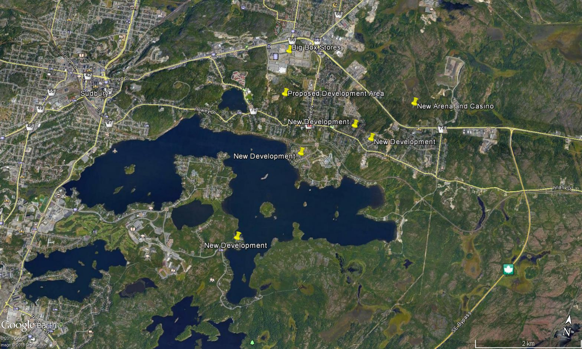
Much of the City’s more recent development has occurred within the Ramsey Lake catchment (Big Box stores plus new residential development, NE of Second Ave. and the lands south of the CP Line/Frobisher Creek)

Slide 7
Within the City of Greater Sudbury
This trend is the City’s Official Plan – creation of New Development areas versus infilling of existing development
Storm water management planning is inadequate and piece meal

Slide 8
Sodium and chloride levels in Ramsey Lake are increasing
Chloride levels are approximately 100 mg/L; the acute aquatic effect level is 125 mg/L
Sodium levels are currently 55 mg/L and exceed Provincial Drinking Water Criteria
Total loadings of road salt to the Ramsey Lake subwatershed: 1,300 metric Tonnes/year
There are no engineering solutions to decrease salt content once in the lake
In 1990 – chloride levels in Minnow Lake
were 232 mg/L and sodium levels were
139 mg/L
2018 levels ?

Slide 9
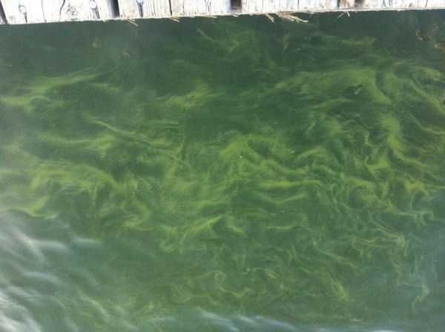
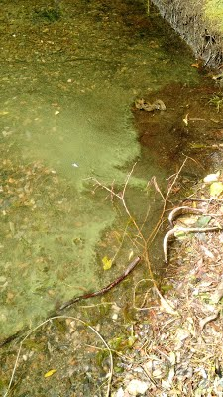
How “likely” is Ramsey Lake to experience cyanobacteria blooms?
Ramsey Lake has a history of concern extending back to the 1960s
Problem persists and results in periodic beach closures
Currently total phosphorus concentrations are 10.4 ug/L (2017) – mesotrophic
Under Global Climate Change this risk will increase (hotter summers, longer winters, more intense and frequent precipitation events, reduced snowfall)
Cyanobacteria production is controlled by levels of soluble reactive phosphorus, iron, degree-days of stratification and food web interactions

Slide 10
Ramsey Lake has a small watershed – results in a limited yield
Water Taking Volumes at the David Street Water Treatment Plant are well quantified under their Permit To Take Water
6,500,000 cubic metres/annum or 40%
Inflows are much less certain and derived from a lake wide water balance
16,000,000 cubic metres/annum
Groundwater contributions unknown – Moonlight Beach Area is a contributor
No hydro-metric or water quantity/quality record other than that collected under the Source Water Protection Plan (approximately 9 months)

Slide 11
Source Water Protection Plan and monitoring are required
Planning efforts to date have taken over 8 years
No staffing has been hired to implement
Sub-watershed plan is now on-going as funded by MOECC
$250K spend by City to install and operate a profiling data sonde during the ice-free season
Instrumentation provides for measurement of pH, temperature, dissolved oxygen, conductivity, temperature and phycocyanin (a blue green surrogate metric) via a web-site
Draft Sub-watershed Plan is pending
Influent water to David Street is monitored per MOECC requirements, but the parameters are not really indicative of the lake’s eutrophication status

Slide 12
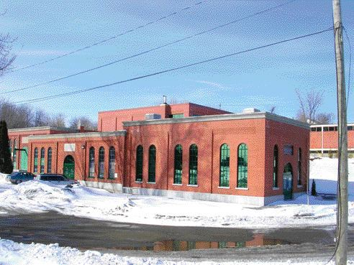
David Street Water Treatment Plant is susceptible to weather and climate change
Climate Change is a significant Societal Risk with broad economic costs
Taking for WTP is significant and has resulted in numerous complaints of interference under drought conditions in the past
Essentially we are peeing in our drinking water supply and hoping it all works out
Replacement cost is estimated at $365M

Slide 13
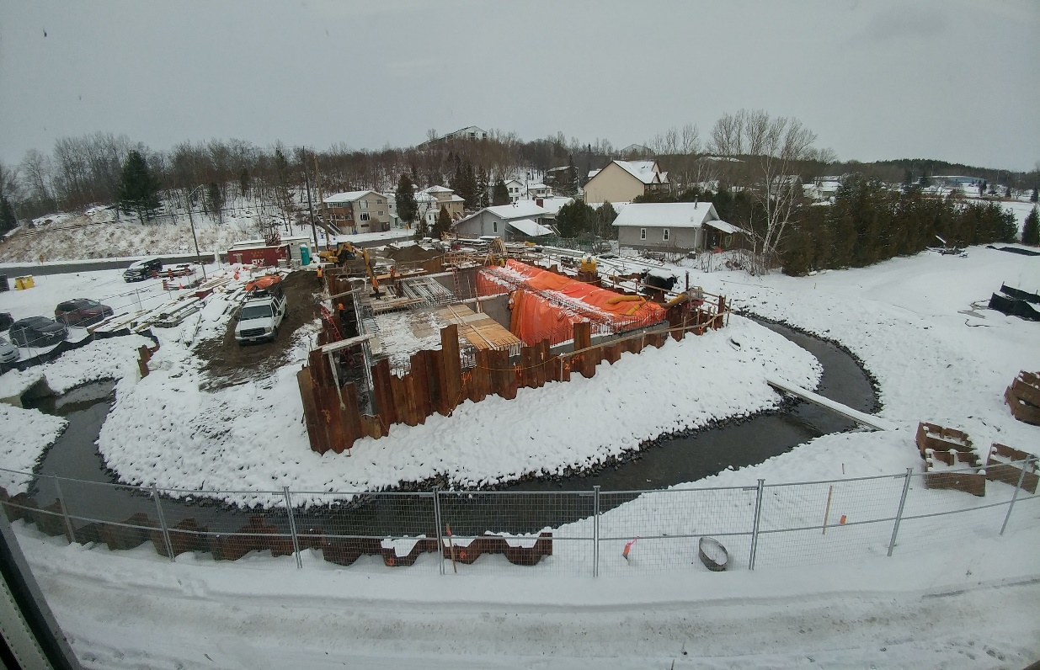
Minnow Lake Update
Construction of the “treatment works” on the St. Jean storm sewer commenced in 2017; completed in Spring 2018
At a cost of $3.3M (twice the engineer’s estimated cost), the City has installed a “grit-separator” on the St. Jean storm sewer
This storm sewer represents 70% of the hydraulic inflow to Minnow Lake
Time to address/implement concerns about this inflow – 30+ years

Slide 14
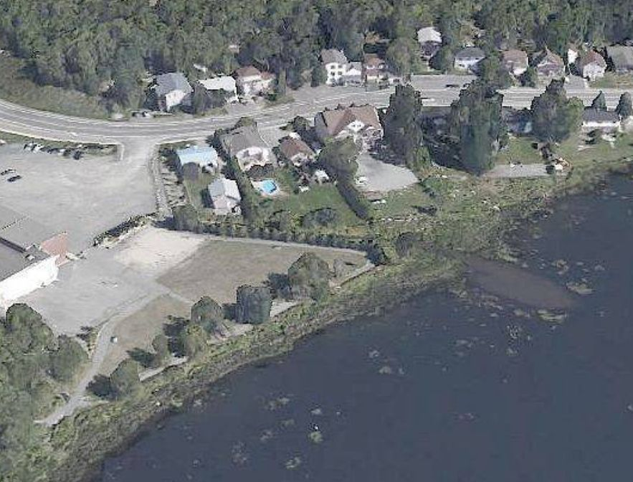
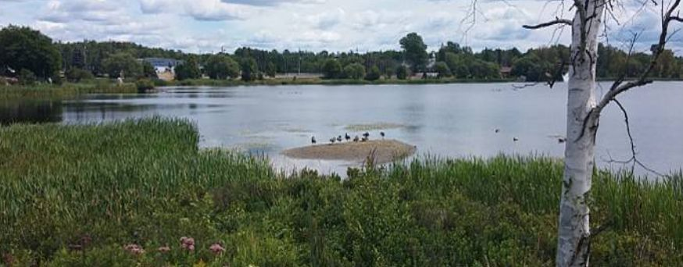
Minnow Lake Update continued
Treatment is primary, and fails to address the real contaminants of concern
Total phosphorus (eutrophication)
Metals (Contaminated sediments)
City has made no commitment to remove the 1,500 cubic metres of coarse sands in Minnow Lake at the mouth of the St. Jean storm sewer nor implement a remedial plan for the lake’s restoration
MOECC and ECCC seem to be hiding in their offices and not following their Regulatory Mandate of polluter pays

Slide 15
What Can the Public Do?
Those of us that do comment are marginalized by City staff and our elected representatives as ill-informed and that our concerns/options do not reflect the Public
We need you and other members of the Community to actively participate in and comment on the pending Ramsey Lake Subwatershed Plan
We all need to sing from the same song sheet
A total moratorium on new development within Ramsey Lake subwatershed
With regard to road salt – a Plan to reduce application rates, and measures to track those reductions (e.g. conductivity measurements of sub-catchments, an usage inventory of road application rates)

Slide 16
What Can the Public Do?
With regard to eutrophication parameters and other Contaminants of Concern
the quantification of loadings from the various contributing sub-watersheds, and the development of a predictive water quality model (e.g. BATHTUB).
budgetary commitments to storm water retrofitting and an implementation review and schedule,
infill development versus new development, and
staged development under redefined BMP’s for storm water.
Re-think the City’s Lakes Program (Is it political window dressing?). Restructure and financially enhance the NDCA in a new role as a local Regulatory Agency.

Slide 17
Thank you for your attention.

