Slide 1


Slide 2
Special Guests: Brad Bowman Tom Price Lionel Rudd

Slide 3
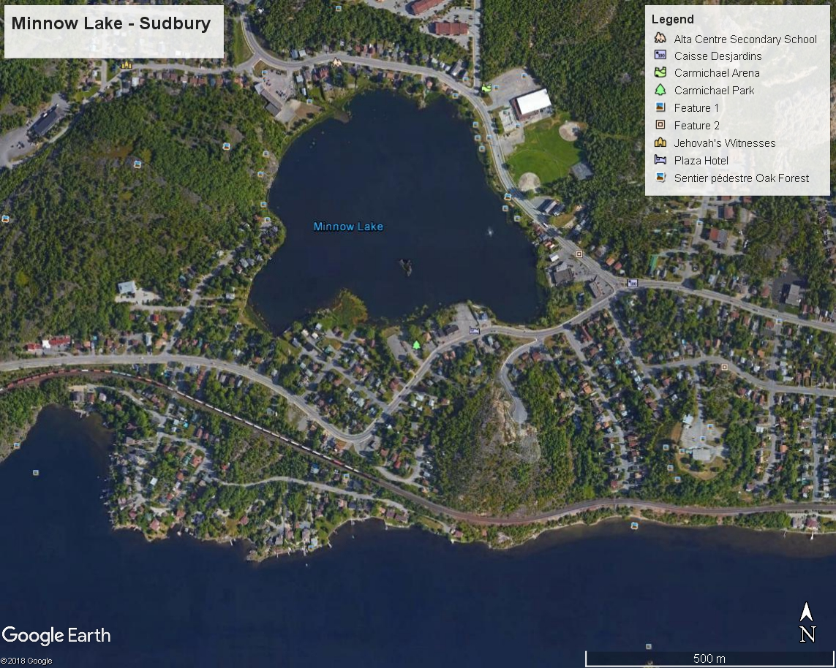

Slide 4
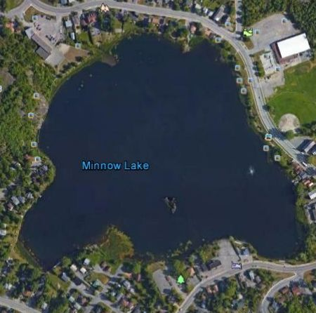

Slide 5
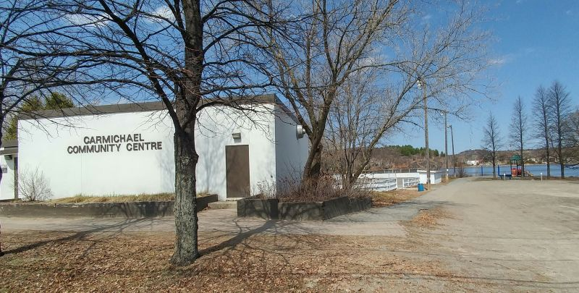
Carmichael Community Centre
New Home of Sudbury Art Club

Slide 6
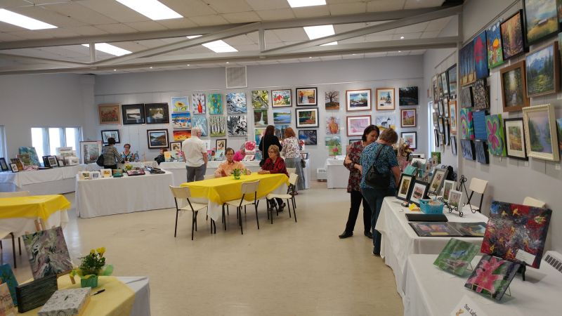
Extensive renovations almost complete

Slide 7
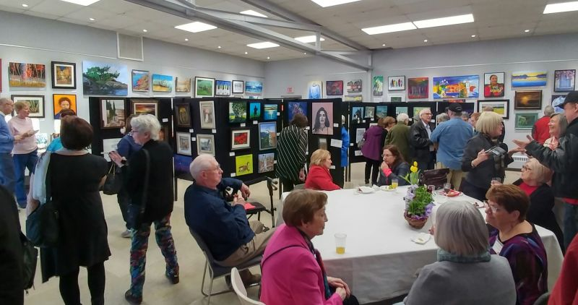
Workshop area and display space

Slide 8
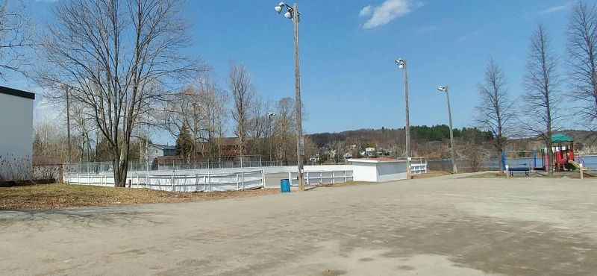
Outside area – rink (future?) and playground

Slide 9
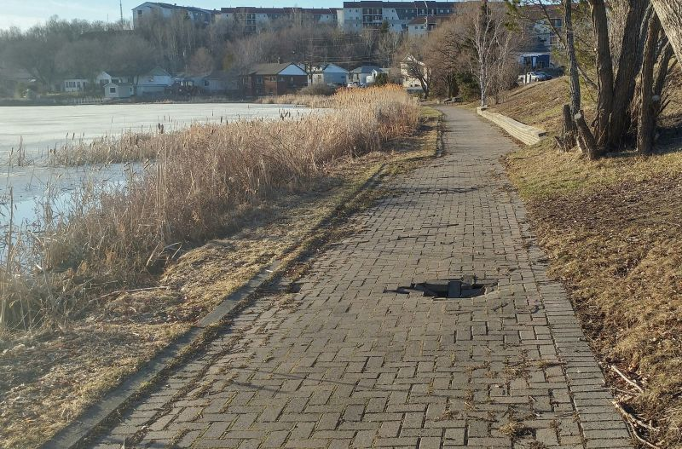
Bancroft Waterfront Park Walkway - danger area

Slide 10
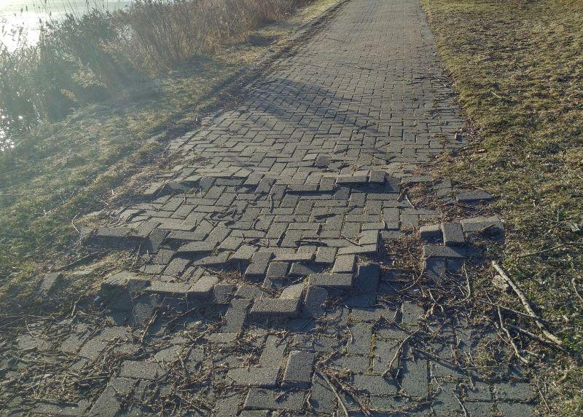
Bancroft Waterfront Walkway – Danger Area - tree root damage

Slide 11
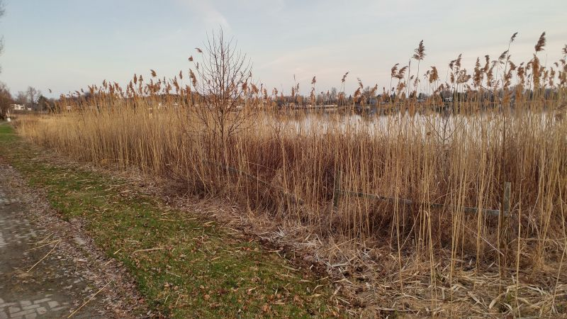
Phragmites (European Common Reed) - Invasive Species

Slide 12
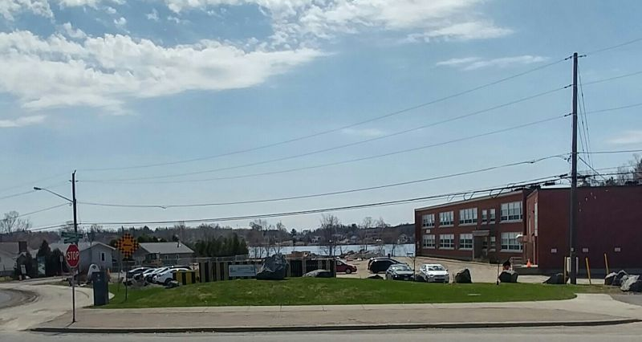
Minnow Lake Place – Home of Meals on Wheels – Our Children Our
Future, Sudbury Minor Hockey and space for Community Usage

Slide 13
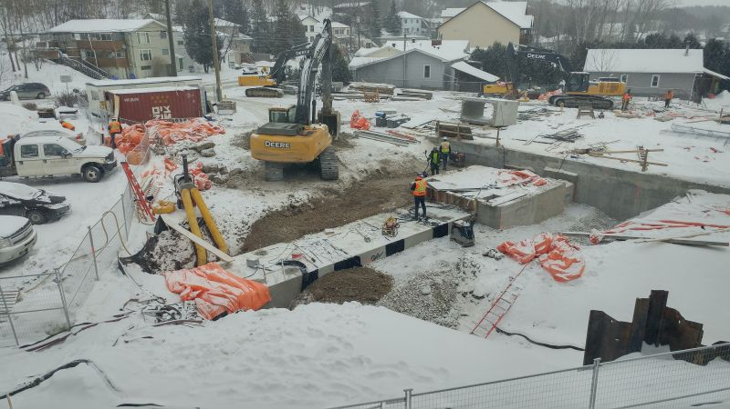
Storm Water Treatment facility installed in parking lot area

Slide 14
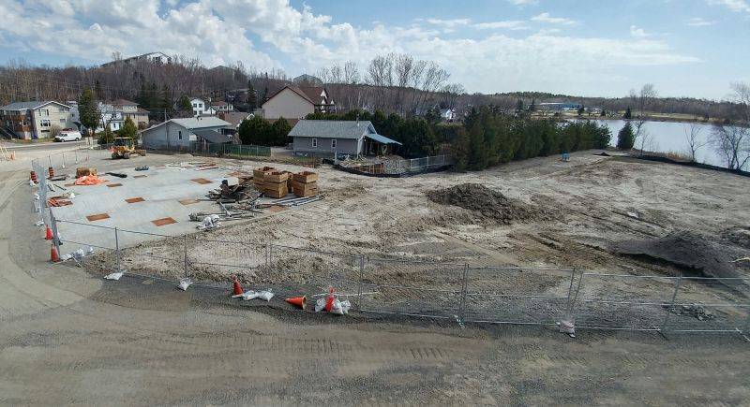
Work Underway to restore area – parking and waterfront park

Slide 15
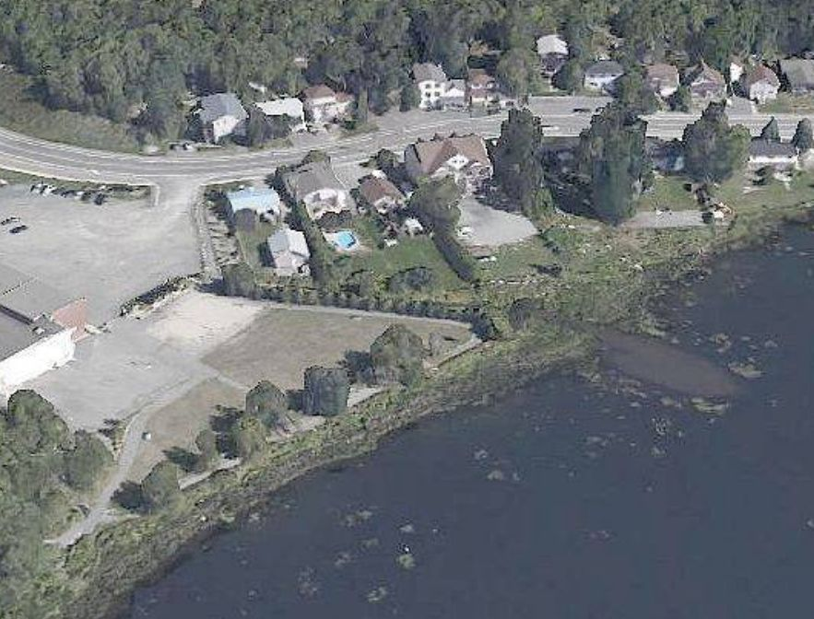
Sediment in lake still to be removed – Brad Bowman will discuss

Slide 16
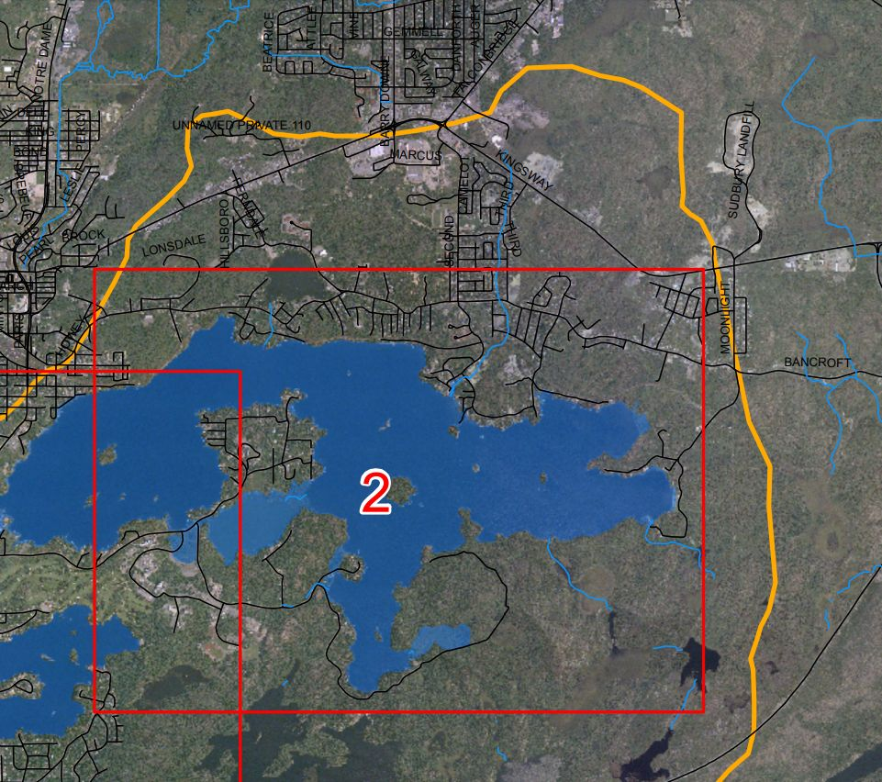
Lake Ramsey watershed (Northern Area) – Tom Price to discuss

Slide 17
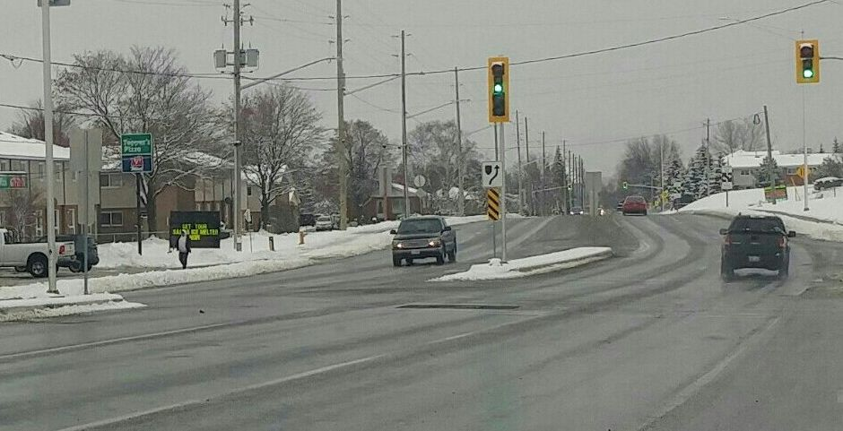
Second Avenue Speedway (some say) Lionel Rudd of
Sudbury Citizens For Safety will discuss

Slide 18
Thank You for Your Interest: Visit us at
www.minnowlake.ca

